Slide 1
GROUP 4

Slide 2







MEMBERS
Nguyễn Thành Đạt
20215194
Nguyễn Như Đại
20215191
Trần Tùng Dương
20215190
Trần Trọng Kỳ
20194784
Ngô Vĩnh Khánh
20215211
Nguyễn Đình Hồng Phong
20215233

Slide 3
01
WORKLOAD CONTRIBUTION
02
OBTAINED DATA STATISTIC
03
UML DIAGRAM
04
PACKAGES FEATURES & EXPLANLATION
05
OOP TECHNIQUE EXPLANATION
06
TECHNOLOGY
07
USER GUIDE

Slide 4
WORKLOAD CONTRIBUTION

Slide 5
Nguyễn Đình Hồng Phong
Nguyễn Thành Đạt
Frontend development
Backend development
Festival data processing
Slide design
Ngô Vĩnh Khánh
Nguyễn Như Đại
Relic data processing
Create package diagram
Figure data processing
Make a report
Plan an idea for solfware.
Trần Tùng Dương
Trần Trọng Kỳ
Dynasty data processing
Make a report
Event data processing
Create class diagram

Slide 6
OBTAINED DATA STATISTIC

Slide 7
Người kể sử
Văn sử
Người kể sử
Người kể sử
Wiki
Wiki
Wiki
DYNASTY
FIGURE
EVENT
RELIC
FESTIVAL
35
2984
156
1069
52
6 attributes
9 attributes
7 attributes
7 attributes
7 attributes
id
name
startYear
endYear
description
figures
id
name
otherName
bornYear
deathYear
parents
dynasties
home
description
id
name
time
location
relatedFigure
dynasty
description
id
name
time
location
description
province
type
figure
id
name
place
firstTimes
startTime
relatedFigure
decription

Slide 8
13 attributes
KING
regnalYear
posthumousName
eraName
heirApparent
Id
Name
otherName
bornYear
deathYear
Parents
Dynasties
Home
description
166
id
name
otherName
bornYear
deathYear
parents
dynasties
home
description
FIGURE
2984
11 attributes
king
graduatedYear
id
name
otherName
bornYear
deathYear
parents
dynasties
home
desc
POINSETTIA
39

Slide 9
UML DIAGRAM

Slide 10
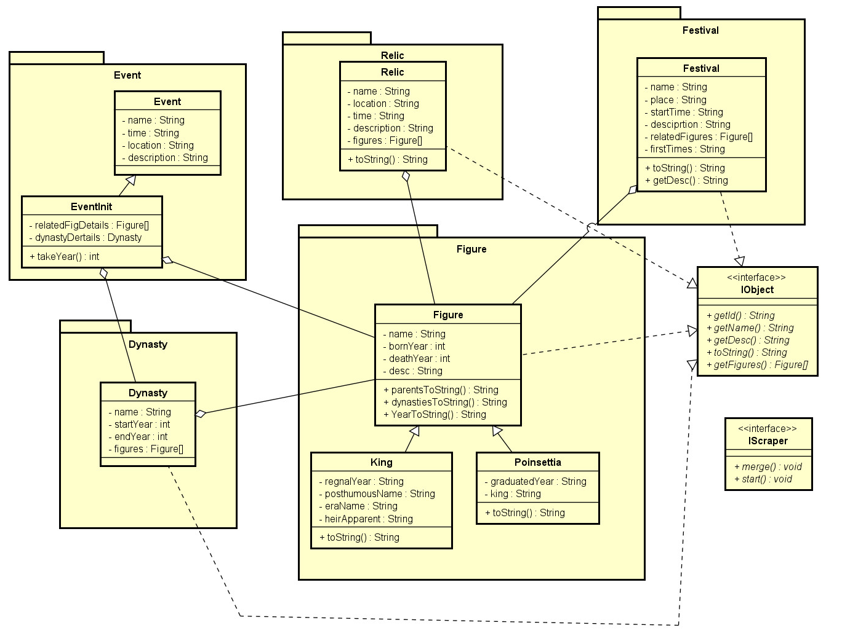
Model’s class diagram

Slide 11
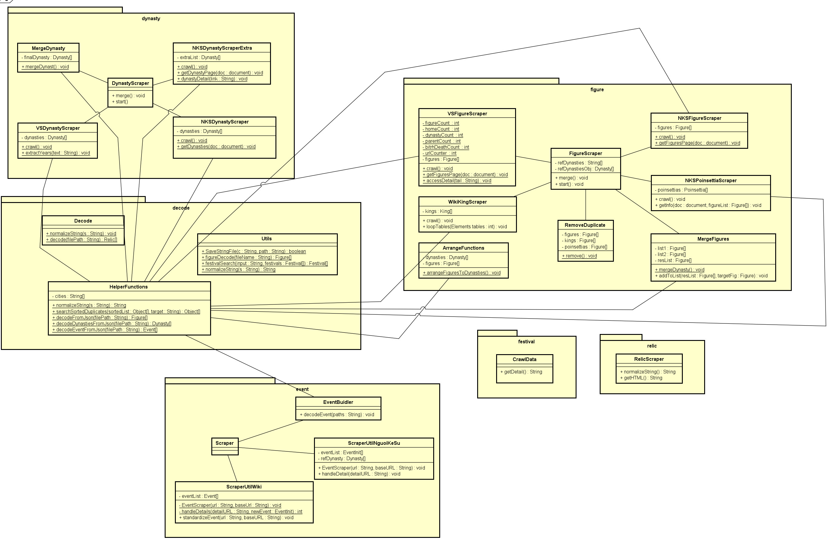
Service’s class diagram

Slide 12
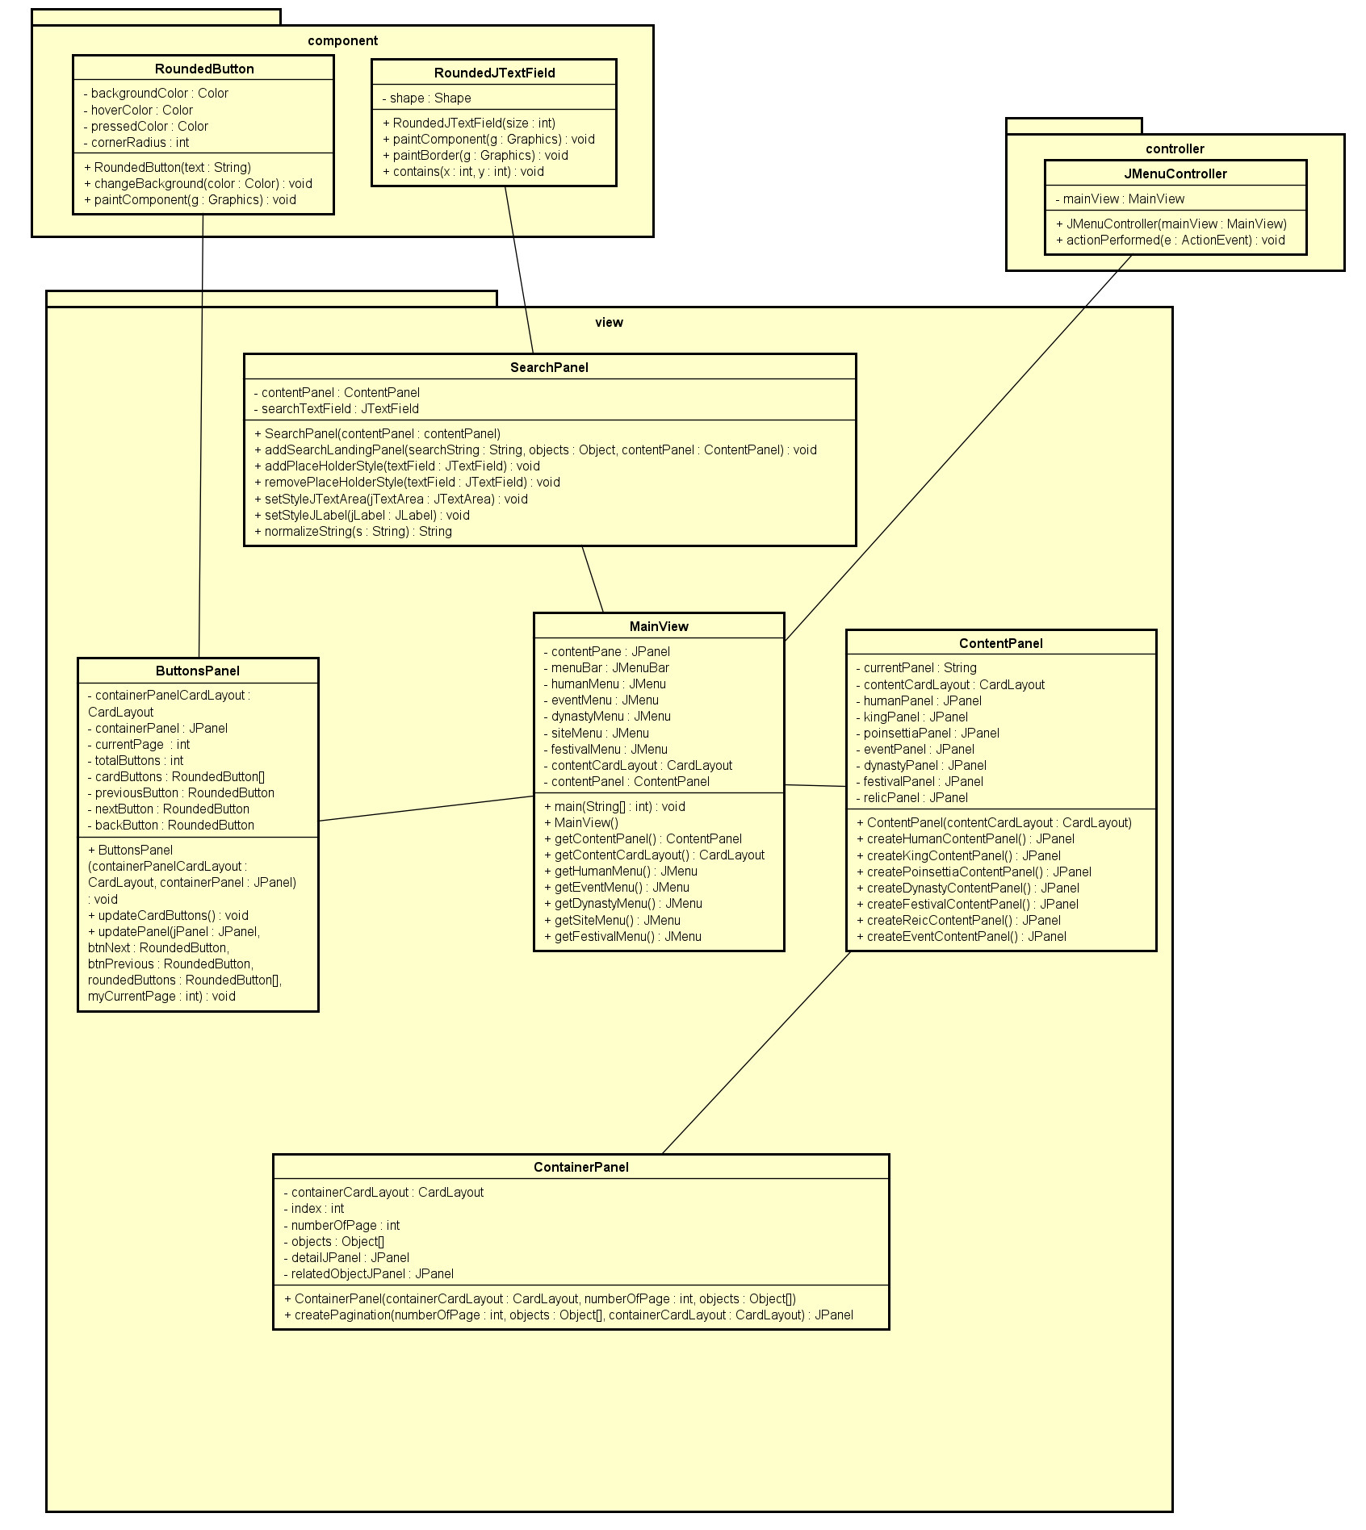
GUI’s class diagram

Slide 13
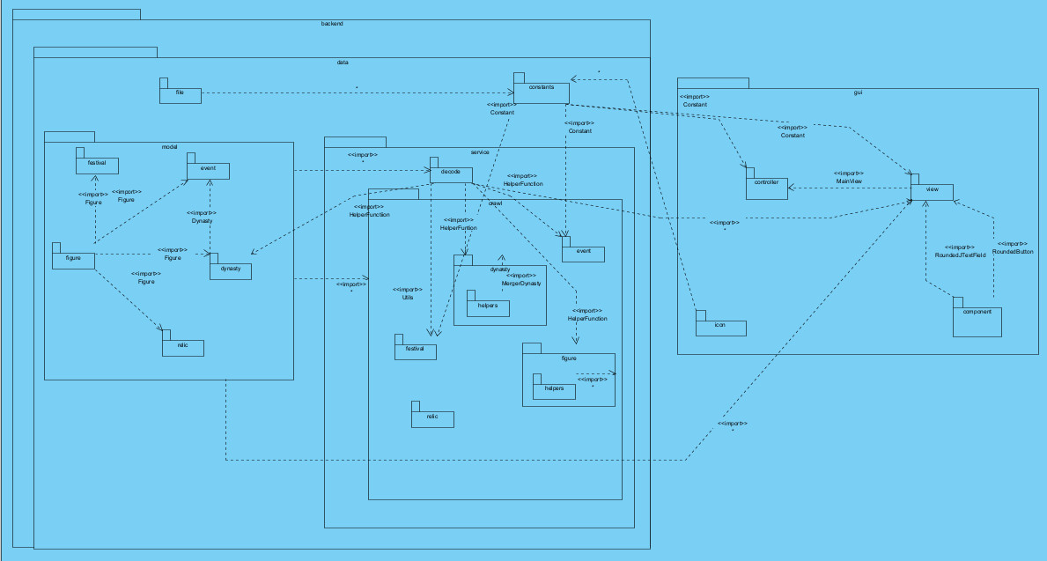
Package diagram

Slide 14
PACKAGES FEATURES & EXPLANLATION

Slide 15

GUI
gui
controller
icon
view
component
Handle the action performed by users when they interact with the menu bar
Contain the icons used in the project
Contain classes to initialize the graphic user interface for the application
Contain classes to initialize other components (buttons, textFields, . . . )

Slide 16
BACKEND
backend
constant
file
model
service
Contain constant variables for the project (name, file path, . . . )
Hold the JSON files of the project that are generated from scraping methods in other
classes
Contain object classes (Dynasty, Figure, . . . . Each is placed into another sub-
package with the same name
Package contains 2 subpackages: ”crawl” (Crawling data from the internet) and ”decode” (decode to array lists for GUI
display )

Slide 17
OOP TECHNIQUE EXPLANATION

Slide 18
Encapsulation
Attributes and methods are encapsulated inside a class and set access-modifier
Inheritance
King, Poinsettia
inherit
Figure
Event
inherit
EventInit
Relic
inherit
Type
inherit
Province

Slide 19
Abstract
Interface IObject: contains 5 unimplemented methods Class Figure, Dynasty,EventInit,
Relic, Festival implements IObject
Polymorphism
Kings and Figures can be downcast to call specific attributes and methods.
List EventInit has element as Event (Upcast technique)

Slide 20
Aggregation
Dynasty
contain
Figure
Event
contain
Dynasty,
Figure
Festival
contain
Figure

Slide 21
Generic programming
When user want to search for any information, ”searchObject” will handle searching functionality
Overriding
Figure, Dynasty, EventInit, Relic, Festival classes implement the interface so they override unimplement methods of IObject
In FigureScraper and DynastyScraper, they both implement Scraper so they override start and merge methods of Scraper

Slide 22
Using Inheritance allows code reuse, promotes specialization.
Encapsulation overuse increases complexity, challenges accessing data
Abtraction will simplifies complex systems, reduces code duplication, and promotes efficient collaboration.
Deep inheritance hierarchies and tight coupling may increase complexity and maintainability problems
Benefit
Polimorphism provides object-oriented design for flexibility, extensibility, and modularity
Drawback
Abstract can lead to disconnected codebase, challenging comprehension and maintenance
Encapsulation can improves data security, modularity, and maintainability in code
Polymorphism introduces indirection, performance overhead, requires careful handling

Slide 23
TECHNOLOGY

Slide 24
3 main technologies
JAVA SWING
GSON
JSOUP
A Java library for converting Java objects
to JSON representation and vice versa.
A Java framework for building desktop GUI applications.
A Java library for parsing and manipulating HTML documents.

Slide 25
USER GUIDE

Slide 26
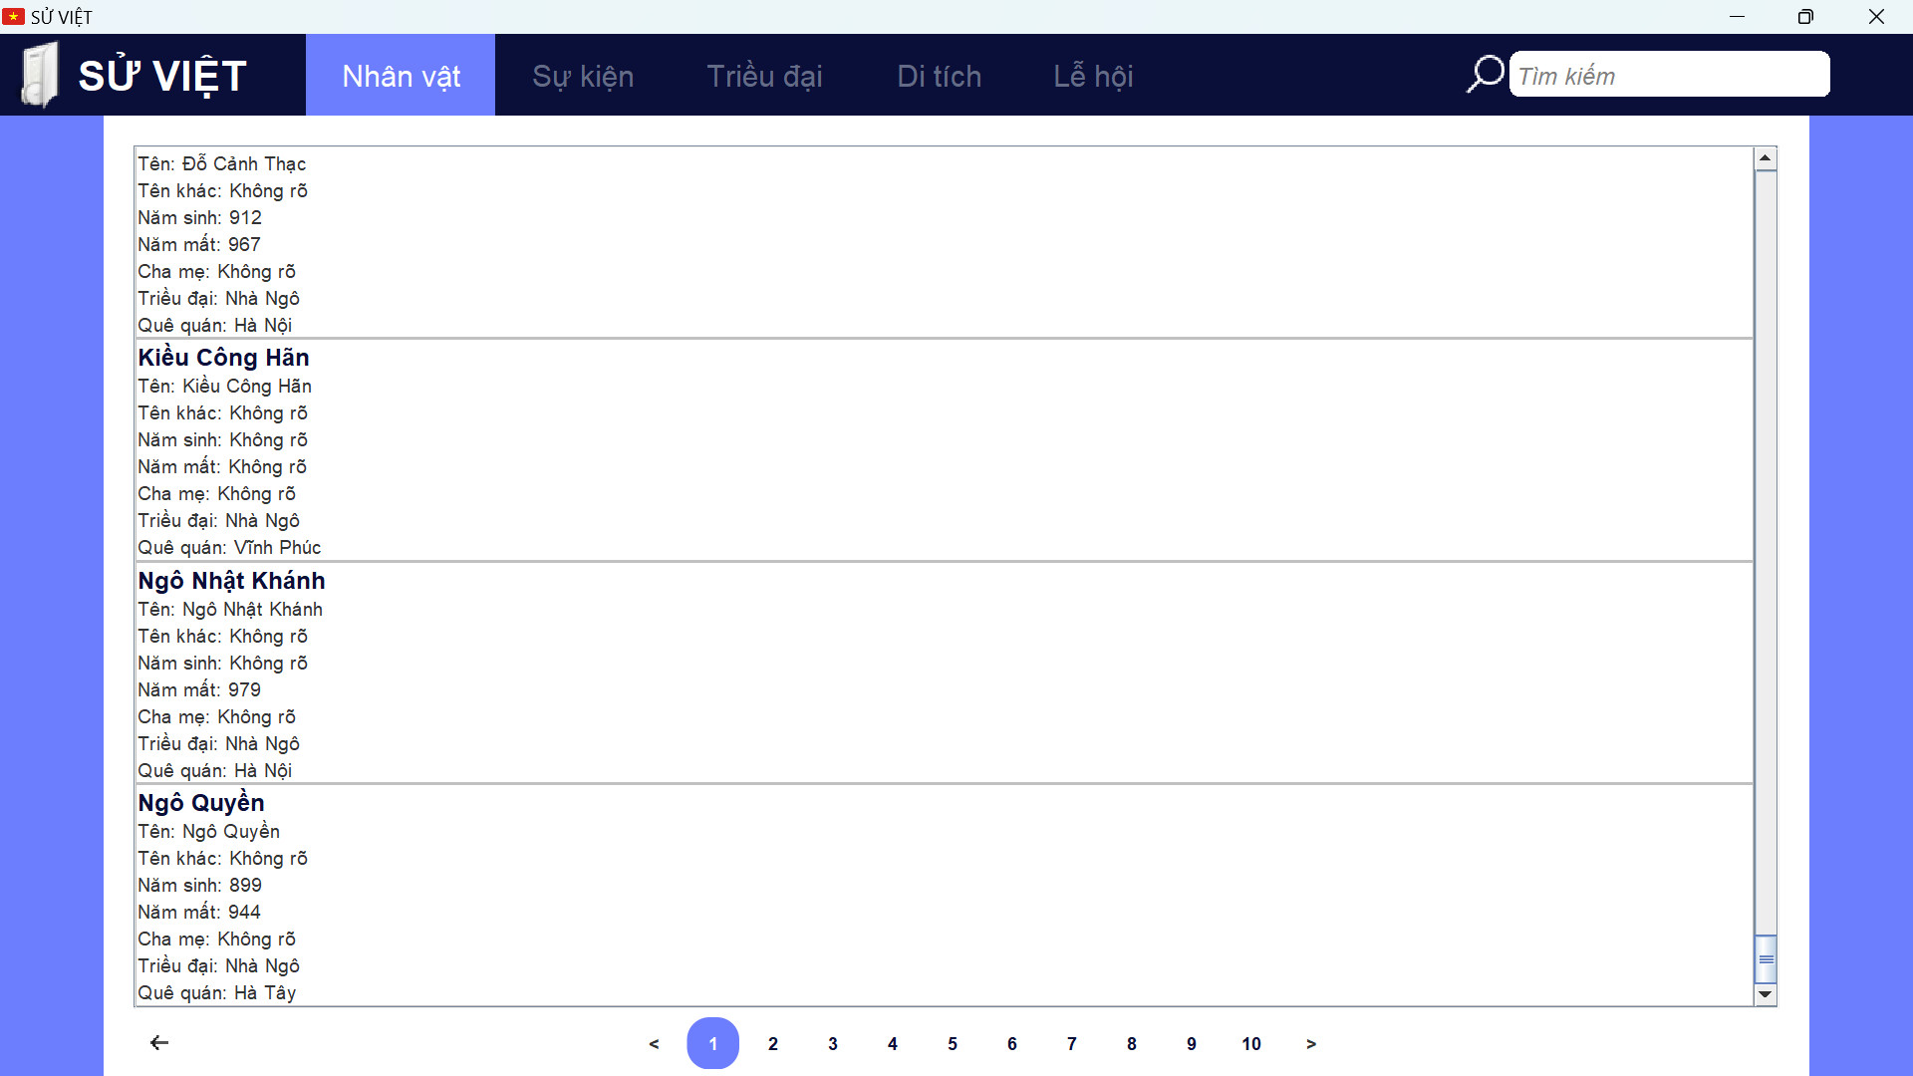
Upon initial run, we have the home screen as below:

Slide 27
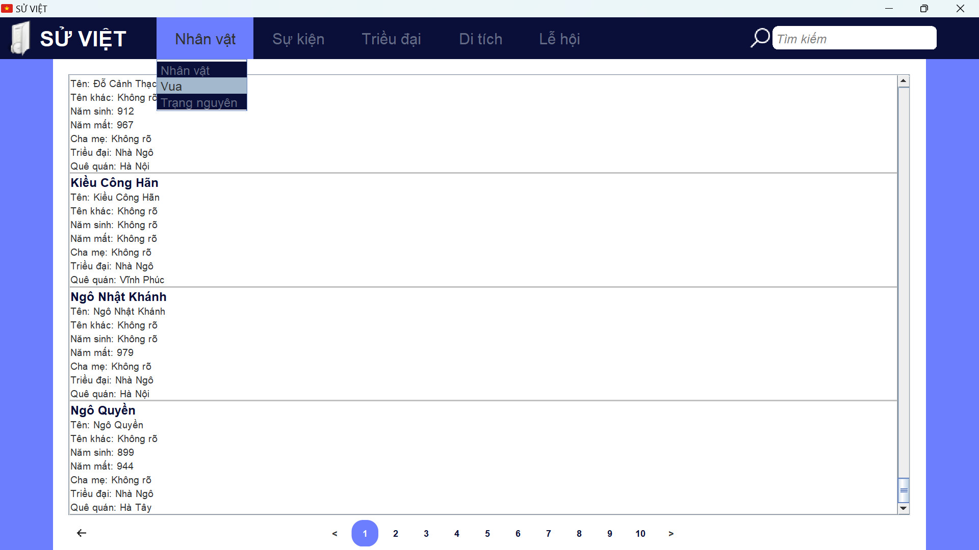
For user to select the information desired, click on any section on Menu bar to open a drop-down. From there, user select the tab they want to see

Slide 28
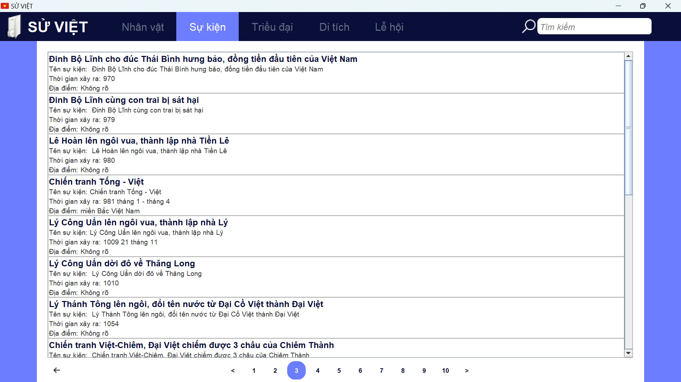
On user selection, the interface will display brief information about related data. User can select pages to be able to view more if there’s any

Slide 29
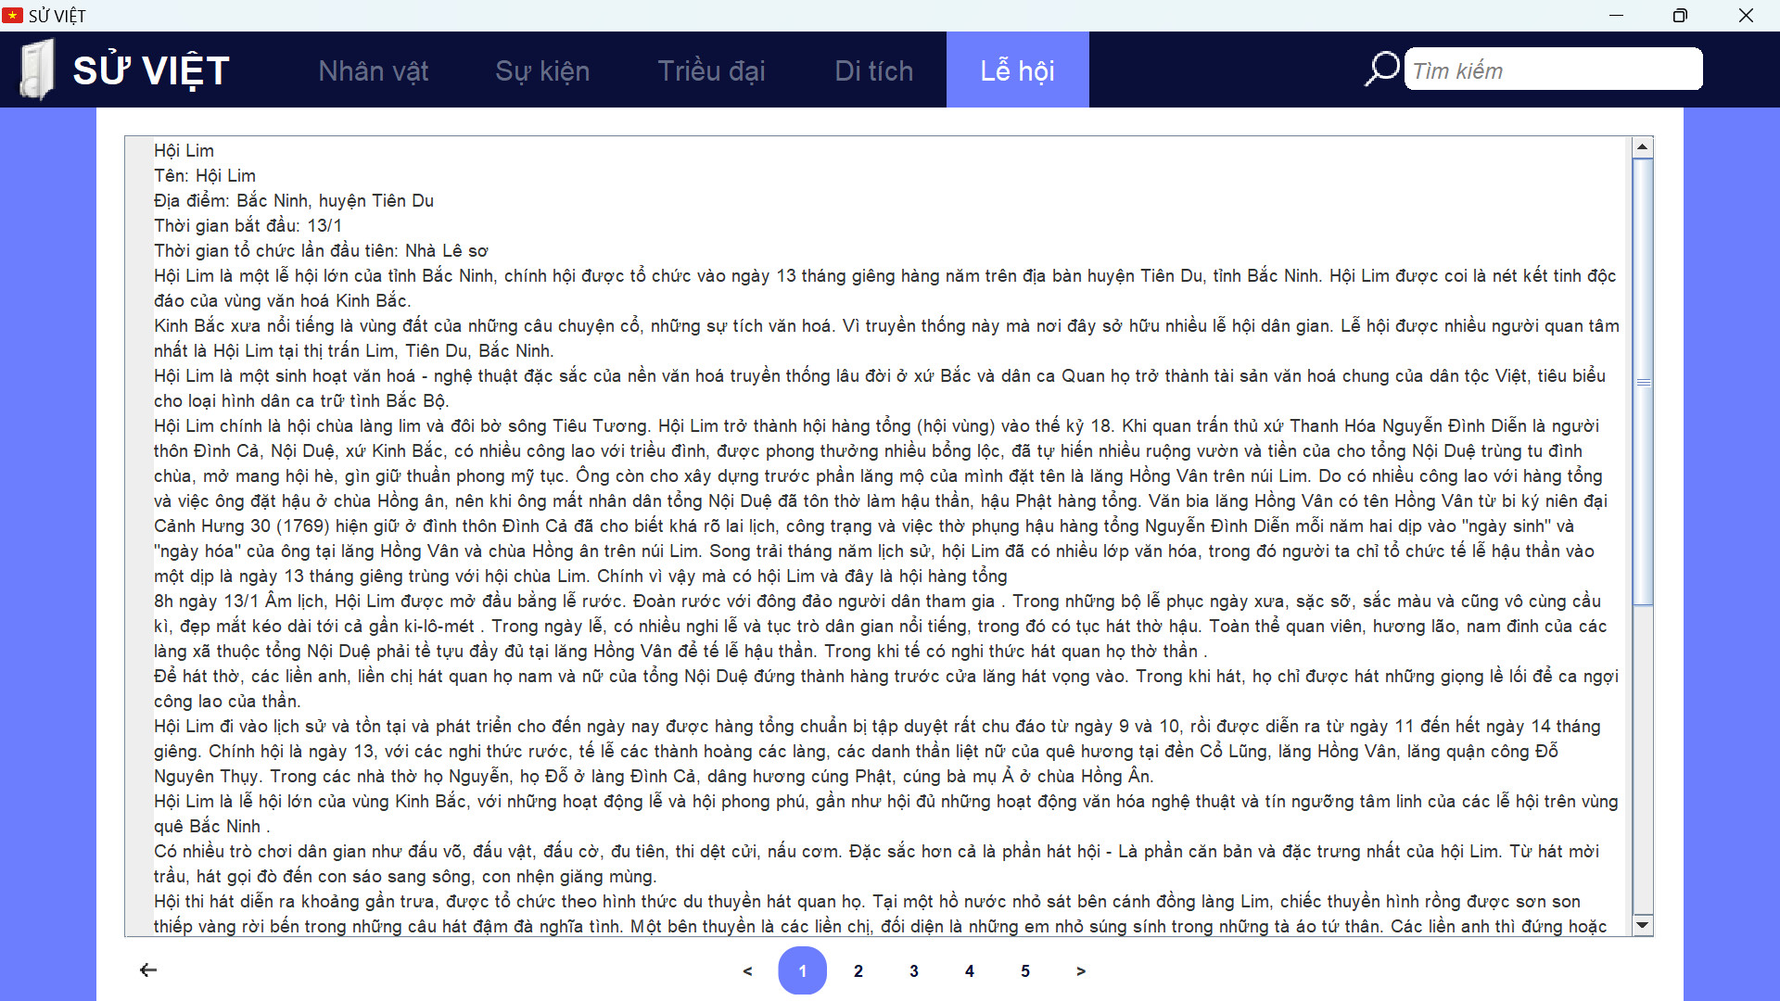
From there, to view detail of a data object, simply click on the name of the data to move to a new page

Slide 30
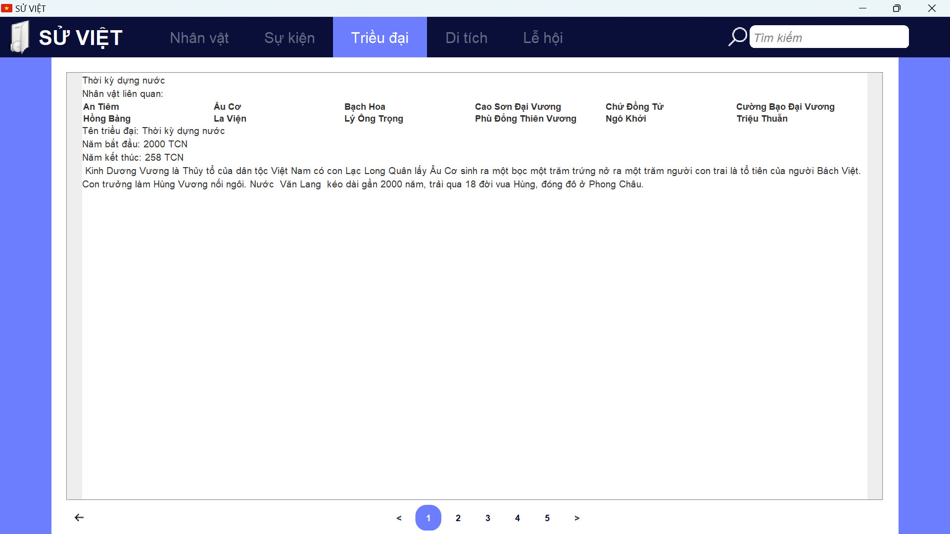
Related data (if exists) will also be displayed inside detail view. User can now click on the data to move to its own detail page

Slide 31
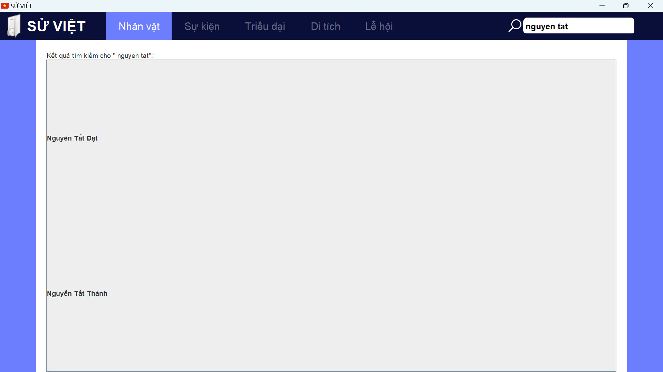
Finally, to search a desired data, user can go to that page and enter the name to the search box. Search functions will search the list by keywords and id to return all related to the screen

Slide 32
THANKS!
Do you have any questions?
Please keep this slide for attribution.

